Slide 1


Recognize how genetic tests used to identify unknown organisms
University of Basrah Al-Zahraa Medical College |  |  | Ministry of higher Education and Scientific Research
 | Academic year 2026-2025 Student Selective Components
This Lecture was prepared by module Staff:
Dr. Enas Ryadh
Dr. Ban M. Saleh
Dr. Hussein K. Abdul-Sada
Dr. Abeer L. Mohammed
Dr. Wameedh Hashim Alqatrani
Dr. Hazim T. Thwiny Dr. Zainab Khalid
Dr. Farqad M. Al-Hamdani
Dr. Shant A. Harotonian
  Jawetz, Melnick, & Adelberg’s Medical Microbiology, 28th Edition
  Clinical Microbiology and Immunology

Slide 2

University of Basrah Al-Zahraa Medical College
Ministry of higher Education and Scientific Research
PCR
Polymerase Chain Reaction (PCR) is a process used to makes copies of a piece of DNA. It's consists of three steps: Denaturation, annealing, and extension. Each PCR stage doubles the number of DNA molecules.
The process is continued for many cycles to generate a huge number of copies.
The process is performed on a PCR cycler or thermal cycler. The PCR cycler heats or cools the PCR mixture at the appropriate time in order to allow denaturation, annealing, or extension

Slide 3

University of Basrah Al-Zahraa Medical College
Ministry of higher Education and Scientific Research
PCR invented by Kary Mullis in 1983, described in 1985, awarded Nobel Prize in 1993.
The technique was made possible by the discovery of Taq DNA polymerase that was used by the Thermus aquaticus.

Slide 4
University of Basrah Al-Zahraa Medical
Ministry of higher Education and Scientific Research
College
Application of PCR
In microbiology and molecular biology : for example, PCR is used in research laboratories in DNA cloning procedures, DNA sequencing.
In Medical diagnostics: PCR is commonly used for the detection of infectious diseases like HIV, hepatitis, and tuberculosis.

Slide 5
University of Basrah Al-Zahraa Medical College
Ministry of higher Education and Scientific Research
In food science : PCR has become increasingly important to the agriculture and food industries as a valuable alternative to traditional detection methods.
PCR is also used in forensics laboratories and is especially useful because only a tiny amount of original DNA is required, for example, sufficient DNA can be obtained from a droplet of blood or a single hair.

Slide 6
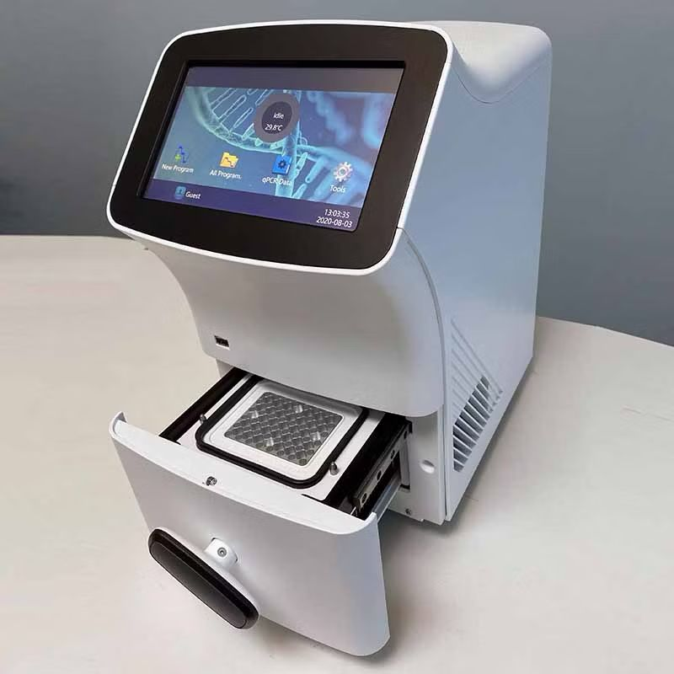
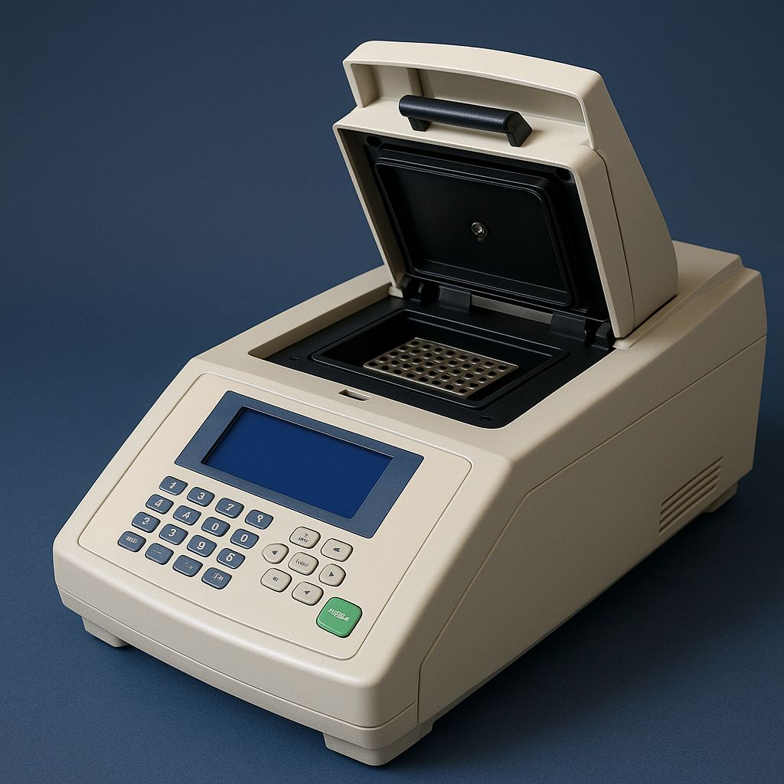
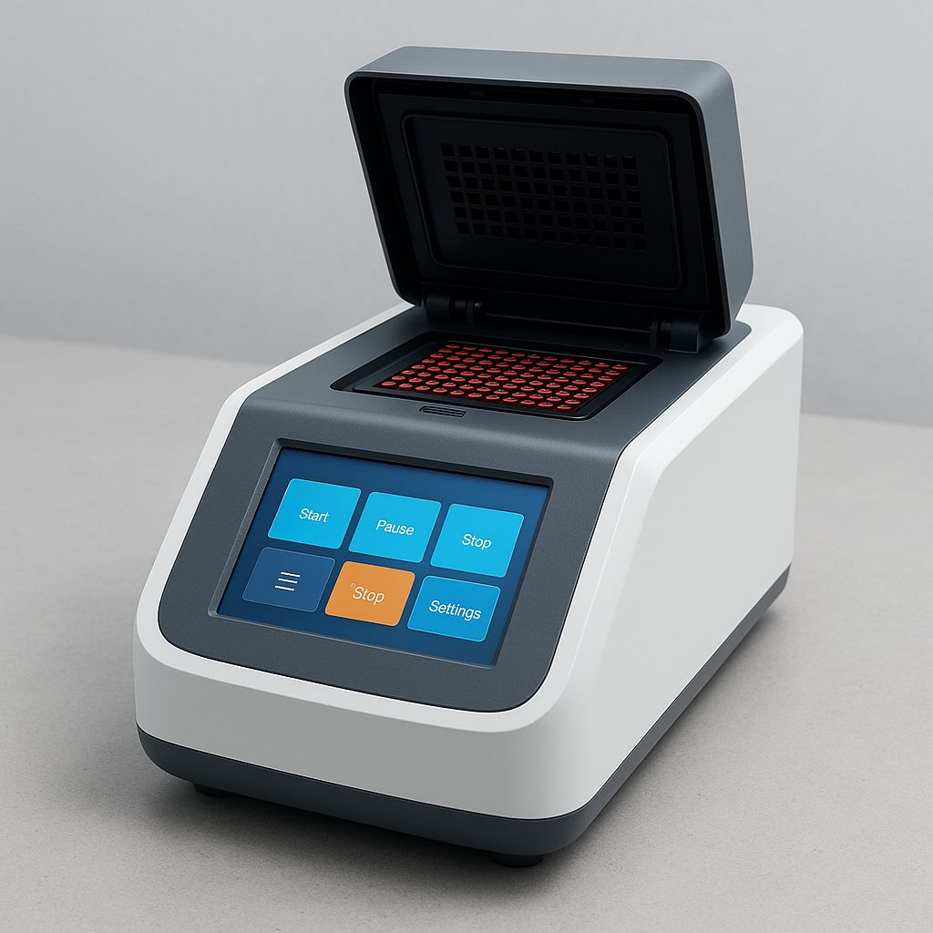
University of Basrah Al-Zahraa Medical
Ministry of higher Education and Scientific Research
College

Slide 7
University of Basrah Al-Zahraa Medical College
Ministry of higher Education and Scientific Research
    The ingredients for PCR (polymerase chain reaction):
    1- DNA template – the source of the specific sequence to be amplified.
    2- Taq polymerase – the enzyme responsible for synthesizing new DNA strands.
    3- Primers – short synthesized strands of DNA that are complementary to the target sequence on the forward and reverse strand.
    4- Deoxynucleotide triphosphates (dNTPs) – the building blocks for the new DNA strands.
    5- Buffer solution – to provide optimal pH and salt conditions for the reaction.
    6- Magnesium chloride (MgCl2) – a cofactor required for Taq polymerase to function correctly.

Slide 8
University of Basrah Al-Zahraa Medical College
Ministry of higher Education and Scientific Research
The principles of PCR include:
1- Denaturation: The double-stranded DNA is heated to a high temperature to separate the two strands.
2- Annealing: The temperature is lowered and short DNA primers anneal (bind) to the complementary sequences at each end of the target DNA.
3- Extension: The temperature is raised again, so the Taq polymerase enzyme can extend the primers and synthesize new strands of DNA.
4- Cycle repetition: This process is repeated multiple times in a thermal cycler to amplify the amount of DNA.

Slide 9
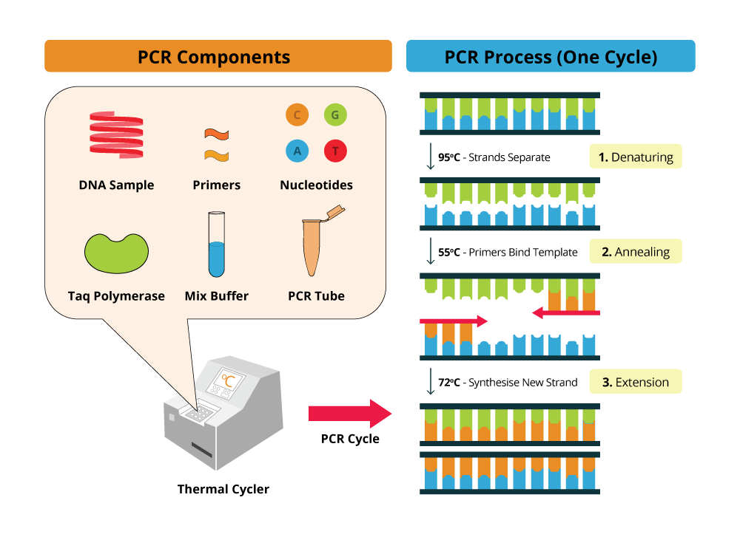
University of Basrah Al-Zahraa Medical
Ministry of higher Education and Scientific Research
College
9

Slide 10
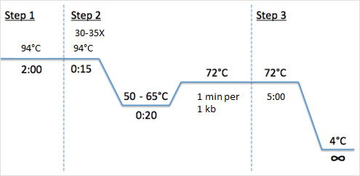
University of Basrah Al-Zahraa Medical
Ministry of higher Education and Scientific Research
College

Slide 11
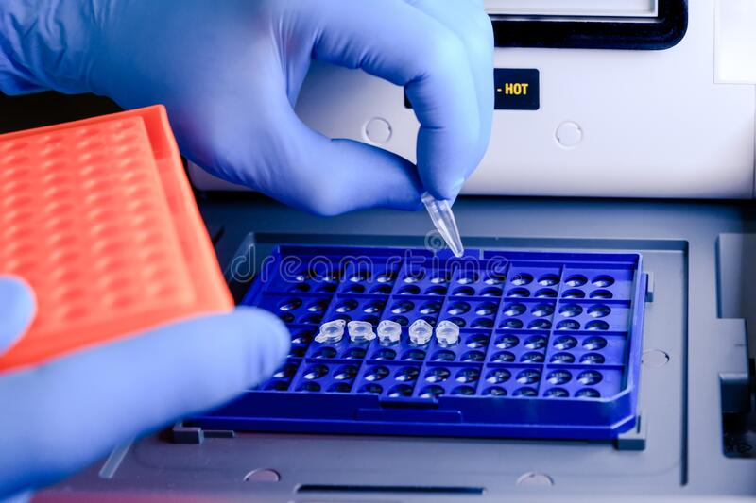

University of Basrah Al-Zahraa Medical College
Ministry of higher Education and Scientific Research

Slide 12

University of Basrah Al-Zahraa Medical
Ministry of higher Education and Scientific Research
PCR products can be detected using various methods such as:
1. Fluorescence-based Detection: Fluorescent dyes such as SYBR Green or TaqMan probes can be used to detect PCR products in real-time PCR.
2. Gel-free Detection: PCR products can be detected without running them on a gel using techniques such as capillary electrophoresis, microfluidics, or high-resolution melt analysis.
3. Hybridization-based Detection: PCR products can be detected using hybridization-based techniques such as Southern blotting or dot blotting.
12

Slide 13
University of Basrah Al-Zahraa Medical College
Ministry of higher Education and Scientific Research
4. DNA Sequencing: PCR products can be sequenced to confirm the presence of the target sequence.
5. Agarose Gel Electrophoresis: PCR products can be separated based on their size by running them on an agarose gel and visualizing them under UV light after staining with ethidium bromide.
Gel electrophoresis is a technique used to separate DNA fragments based on their size and charge. It is commonly used in molecular biology and genetics research to analyze and quantify DNA samples.

Slide 14
University of Basrah Al-Zahraa Medical College
Ministry of higher Education and Scientific Research
The process of gel electrophoresis involves the following steps:
1- Preparation of the gel: A gel is prepared by mixing a highly purified form of agarose with a buffer solution to make a solid gel. The gel is then placed in a tray or a chamber with wells at one end.
2- Loading of DNA samples: The DNA samples are mixed with a loading buffer containing a tracking dye that will allow for the visualization of the DNA fragments as they move through the gel. The samples are then loaded into the wells using a micropipette.

Slide 15

University of Basrah Al-Zahraa Medical
Ministry of higher Education and Scientific Research
College
3- Electrophoresis: An electric current is passed through the gel from one end to the other, which causes the DNA fragments to move towards the positive electrode. The movement of the DNA fragments is based on their size and charge, with smaller fragments moving faster than larger fragments.
4- Visualization of DNA fragments: Once the electrophoresis is complete, the gel is stained with a DNA-specific stain, such as ethidium bromide, which fluoresces under UV light. The bands of DNA fragments can then be visualized and analyzed by placing the gel under UV light.

Slide 16
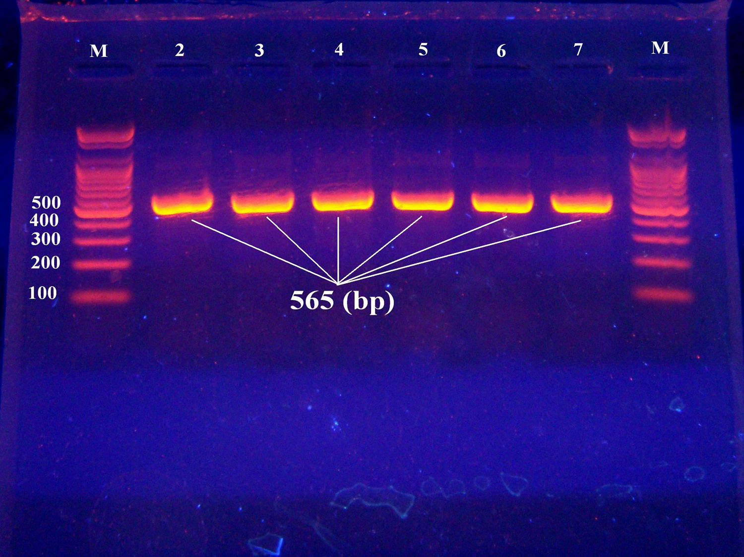
University of Basrah Al-Zahraa Medical
Ministry of higher Education and Scientific Research
College
By analyzing the size and weight of the DNA fragments, researchers can make conclusions about the composition of the original DNA sample. This technique is used for many applications, such as genetic mapping, DNA sequencing, and forensic DNA analysis.

Slide 17
University of Basrah Al-Zahraa Medical College
Ministry of higher Education and Scientific Research
Advantages of PCR
Extremely high sensitivity, may detect down to one microb genome per sample volume.
High specificity.
Easy to set up.
Fast turnaround time.

Slide 18
University of Basrah Al-Zahraa Medical
Ministry of higher Education and Scientific Research
College
Disadvantages of PCR
Extremely liable to contamination.
High degree of operator skill required.
Not easy to quantitate results.
A positive result may be difficult to interpret, especially with latent viruses such as CMV, where any seropositive person will have virus present in their blood irrespective whether they have disease or not.

Slide 19


